Slide 1
Pulse Transformer
Muhaimin Bin Munir

Slide 2
Application of Pulse Transformer
To change the amplitude and impedance level of a pulse
To invert the polarity of a pulse; also to provide with the aid of center-tapped winding, equal positive and negative pulses simultaneously.
To produce a pulse in a circuit having negligible d-c resistance
To effect “d-c isolation” between source and a load; in other words, to produce a pulse in a winding whose d-c voltage level may be arbitrarily selected
To couple between stages of pulse amplifiers
To differentiate a pulse
To act as a coupling element in certain pulse-generating circuits such as the blocking oscillator and multiar

Slide 3
Advantages
Passive circuit element
Stable
No additional voltage required for operation
Separates High voltage power circuit from Low voltage power circuit
Small in size (High frequency)
Multiple components in secondary

Slide 4
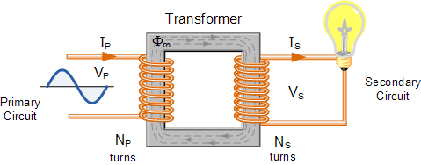
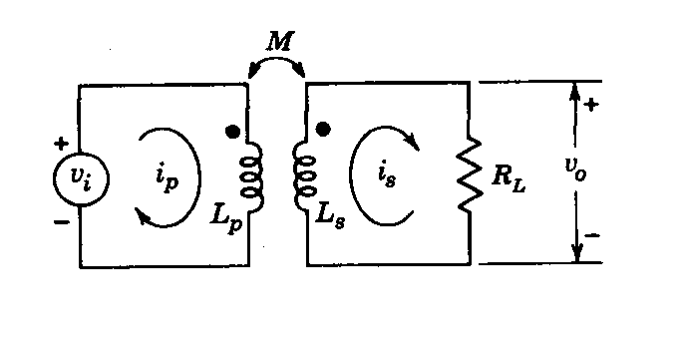
Transformer
Fig: Diagram of a Transformer
Fig: Schematic Diagram of a Transformer

Slide 5
Coefficient of Coupling
L_{P} = Primary Inductance L_{S} = Secondary Inductance M = Mutual Inductance R_{L} = Load Resistance K = Coefficient of Coupling K = M/√(L_{P}L_{S})
Things we ignored
Primary Resistance
Secondary Resistance
Source Resistance
Capacitance
Core Loss
Non-linear behaviour of magnetic ckt

Slide 6
η = v_{o}/v_{i} = i_{P} /i_{S} = √(L_{P}/L_{S}) = N_{S}/N_{P}

Slide 7
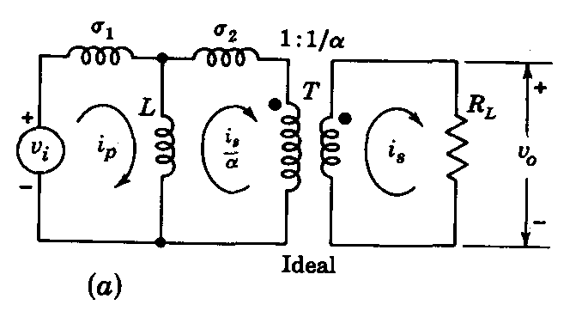
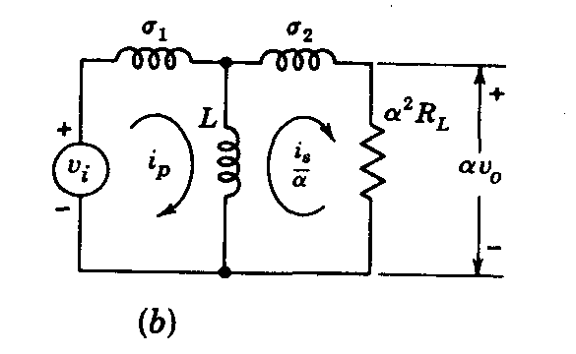

Slide 8
Equivalent Circuit...
1/α = Transformation Ratio α = constant i_{S}/α = Load current reflected into primary α²R_{L}= Load Resistance reflected into primary Still Unknown σ₂ = ? σ₁ = ? L = ?

Slide 9
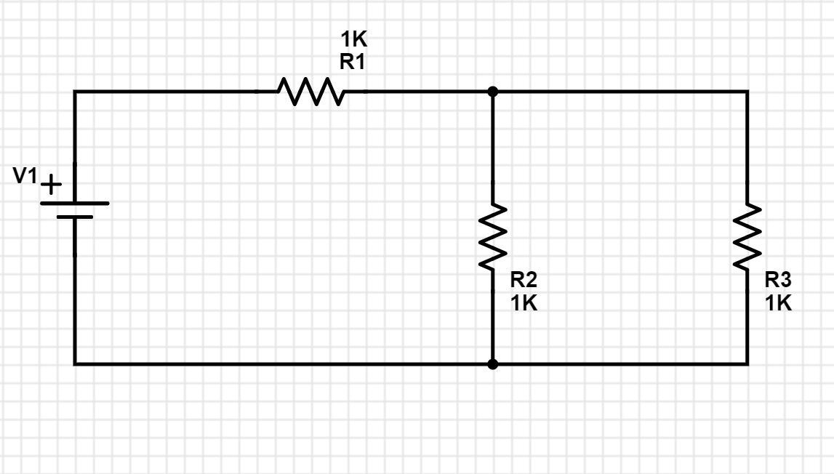
Equivalent Circuit...
V₁ = (R₁+R₂)i₁ - R₂i₂ 0 = (R₂+R₃)i₂ - R₂i₁
v_{i} = L_{P}di_{p}/dt - Mdi_{s}/dt 0 = -Mdi_{p}/dt + L_{s}di_{s}/dt + i_{s}R_{L}
v_{i} = (σ₁ + L)di_{p}/dt - L d/dt(i_{s}/α) 0 = -Ldi_{p}/dt +(σ₂ + L) d/dt(i_{s}/α) + α²R_{L}(i_{s}/α) = -L/α di_{p}/dt +(σ₂ + L)/α² d/dt(i_{s}) + R_{L}(i_{s})

Slide 10
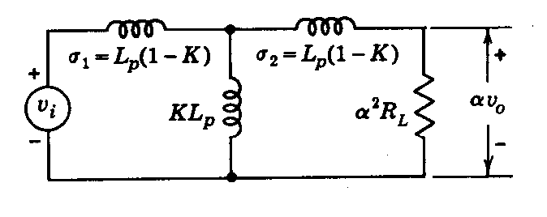
Equivalent Circuit...
L = αM σ₂ = α²L_{s}- αM σ₁ = L_{P}- αM
Case: 1
α = √(L_{P} /L_{s})
σ₁ = L_{P}(1-K) σ₂ = L_{P}(1-K) L = KL_{P}

Slide 11
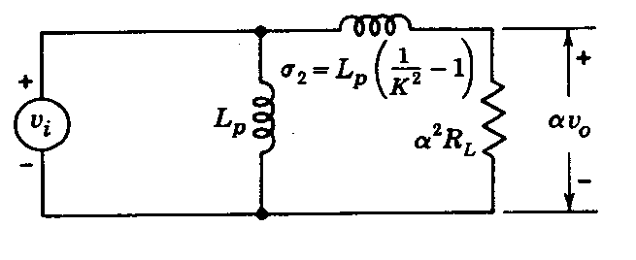
Equivalent Circuit...
L = αM σ₂ = α²L_{s}- αM σ₁ = L_{P}- αM
Case: 2
α = 1/K √(L_{P} /L_{s})
σ₁ = 0 σ₂ = L_{P}(1/K² - 1) L = L_{P}

Slide 12
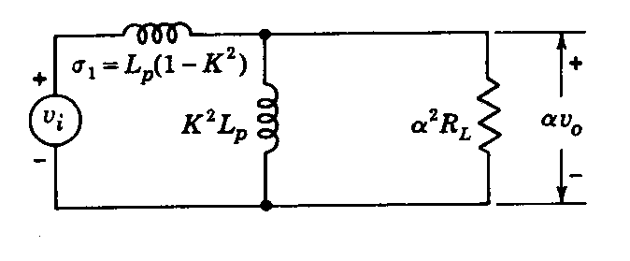
Equivalent Circuit...
L = αM σ₂ = α²L_{s}- αM σ₁ = L_{P}- αM
Case: 3
α = K √(L_{P} /L_{s})
σ₁ = L_{P}(1 - K²) σ₂ = 0 L = K²L_{P}

Slide 13
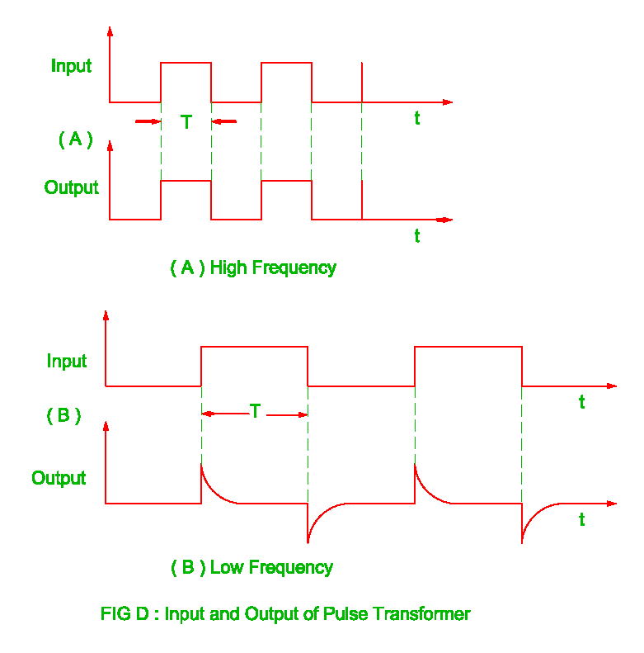
Output of Pulse Transformer
L/R_{o} > 10T [High Frequency]
L/R_{o} < T/10 [Low Frequency]

Slide 14
Fortune and misfortune are like twisted ropes, so they come by turns.
-Captain Ri Jeong Hyeok

